Slide 1
Tries

Slide 2
What is Trie?
Trie is a type of k-ary search tree used for storing and searching a specific key from a set. Using Trie, search complexities can be brought to optimal limit (key length).
A trie (derived from retrieval) is a multiway tree data structure used for storing strings over an alphabet. It is used to store a large amount of strings. The pattern matching can be done efficiently using tries.
Trie is also known as digital tree or prefix tree.
Trie data structure is defined as a Tree based data structure that is used for storing some collection of strings and performing efficient search operations on them. The word Trie is derived from reTRIEval, which means finding something or obtaining it.
Trie follows some property that If two strings have a common prefix then they will have the same ancestor in the trie. A trie can be used to sort a collection of strings alphabetically as well as search whether a string with a given prefix is present in the trie or not.
The trie shows words like allot, alone, ant, and, are, bat, bad. The idea is that all strings sharing common prefix should come from a common node. The tries are used in spell checking programs.

Slide 3
What is Trie?
Preprocessing pattern improves the performance of pattern matching algorithm. But if a text is very large then it is better to preprocess text instead of pattern for efficient search.
A trie is a data structure that supports pattern matching queries in time proportional to the pattern size.
If we store keys in a binary search tree, a well balanced BST will need time proportional to M * log N, where M is the maximum string length and N is the number of keys in the tree. Using Trie, the key can be searched in O(M) time. However, the penalty is on Trie storage requirements

Slide 4
Need for Trie Data Structure?
A Trie data structure is used for storing and retrieval of data and the same operations could be done using another data structure which is Hash Table but Trie can perform these operations more efficiently than a Hash Table.
Moreover, Trie has its own advantage over the Hash table. A Trie data structure can be used for prefix-based searching whereas a Hash table can’t be used in the same way.

Slide 5
Advantages of Trie Data Structure over a Hash Table
The A trie data structure has the following advantages over a hash table:
We can efficiently do prefix search (or auto-complete) with Trie.
We can easily print all words in alphabetical order which is not easily possible with hashing.
There is no overhead of Hash functions in a Trie data structure.
Searching for a String even in the large collection of strings in a Trie data structure can be done in O(L) Time complexity, Where L is the number of words in the query string. This searching time could be even less than O(L) if the query string does not exist in the trie.

Slide 6
Properties of a Trie Data Structure
Below are some important properties of the Trie data structure:
There is one root node in each Trie.
Each node of a Trie represents a string and each edge represents a character.
Every node consists of hashmaps or an array of pointers, with each index representing a character and a flag to indicate if any string ends at the current node.
Trie data structure can contain any number of characters including alphabets, numbers, and special characters. But for this article, we will discuss strings with characters a-z. Therefore, only 26 pointers need for every node, where the 0th index represents ‘a’ and the 25th index represents ‘z’ characters.
Each path from the root to any node represents a word or string.

Slide 7
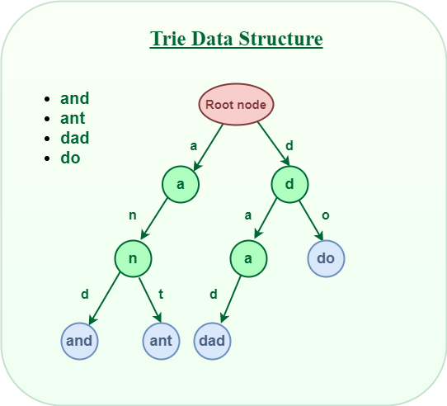

Slide 8
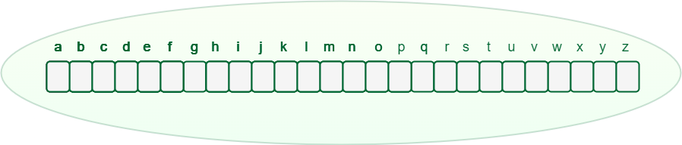
How does Trie Data Structure work?
Trie data structure can contain any number of characters including alphabets, numbers, and special characters.
Here strings with characters a-z are considered. Therefore, only 26 pointers need for every node, where the 0th index represents ‘a’ and the 25th index represents ‘z’ characters.
Any lowercase English word can start with a-z, then the next letter of the word could be a-z, the third letter of the word again could be a-z, and so on.
So for storing a word, we need to take an array (container) of size 26 and initially, all the characters are empty as there are no words and it will look as shown below.
An array of pointers inside every Trie node

Slide 9
How does Trie Data Structure work?
Let’s see how a word “and” and “ant” is stored in the Trie data structure:
Store “and” in Trie data structure:
The word “and” starts with “a“, So we will mark the position “a” as filled in the Trie node, which represents the use of “a”.
After placing the first character, for the second character again there are 26 possibilities, So from “a“, again there is an array of size 26, for storing the 2nd character.
The second character is “n“, So from “a“, we will move to “n” and mark “n” in the 2nd array as used.
After “n“, the 3rd character is “d“, So mark the position “d” as used in the respective array.

Slide 10
How does Trie Data Structure work?
Store “ant” in the Trie data structure:
The word “ant” starts with “a” and the position of “a” in the root node has already been filled. So, no need to fill it again, just move to the node ‘a‘ in Trie.
For the second character ‘n‘ we can observe that the position of ‘n’ in the ‘a’ node has already been filled. So, no need to fill it again, just move to node ‘n’ in Trie.
For the last character ‘t‘ of the word, The position for ‘t‘ in the ‘n‘ node is not filled. So, filled the position of ‘t‘ in ‘n‘ node and move to ‘t‘ node.

Slide 11
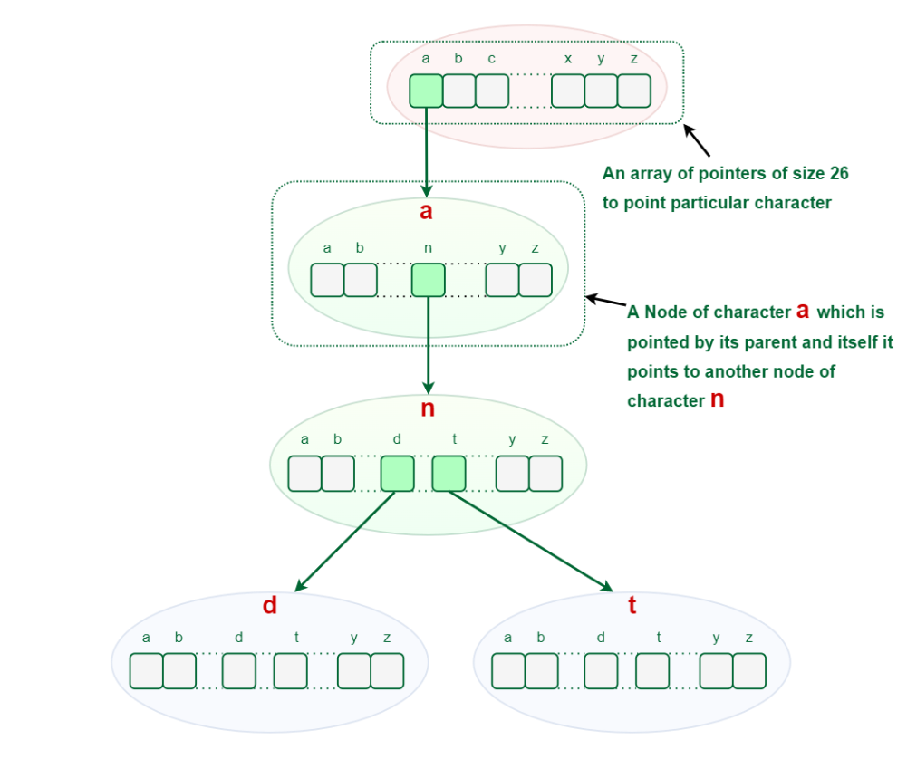
How does Trie Data Structure work?
After storing the word “and” and “ant” the Trie will look like this:

Slide 12
Representation of Trie node
Every Trie node consists of a character pointer array or hashmap and a flag to represent if the word is ending at that node or not. But if the words contain only lower-case letters (i.e. a-z), then we can define Trie Node with an array instead of a hashmap.
struct TrieNode
{
struct TrieNode* children[ALPHABET_SIZE];
// This will keep track of number of strings that are
// stored in the Trie from root node to any Trie node.
int wordCount = 0;
};

Slide 13
Basic Operations on Trie Data Structure
Insertion
Search
Deletion

Slide 14
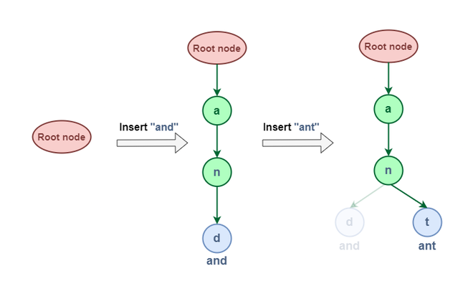
1. Insertion in Trie Data Structure
This operation is used to insert new strings into the Trie data structure
Let us try to Insert “and” & “ant” in this Trie:
The word “and” & “ant” have shared some common node (i.e “an”) this is because of the property of the Trie data structure that If two strings have a common prefix then they will have the same ancestor in the trie.

Slide 15
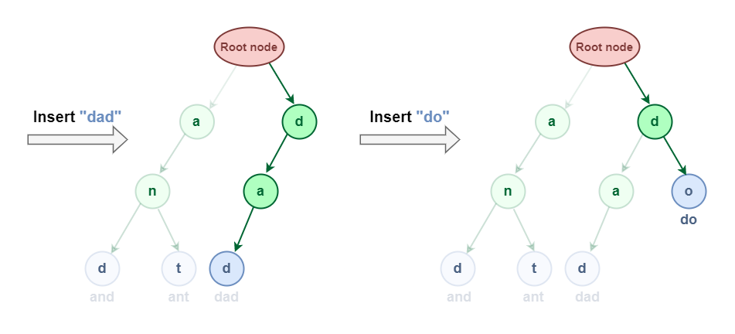
1. Insertion in Trie Data Structure
Now let us try to Insert “dad” & “do”:

Slide 16
Algorithm
Define a function insert(TrieNode *root, string &word) which will take two parameters one for the root and the other for the string that we want to insert in the Trie data structure.
Now take another pointer currentNode and initialize it with the root node.
Iterate over the length of the given string and check if the value is NULL or not in the array of pointers at the current character of the string.
If It’s NULL then, make a new node and point the current character to this newly created node.
Move the curr to the newly created node.
Finally, increment the wordCount of the last currentNode, this implies that there is a string ending currentNode.

Slide 17
void insert_key(TrieNode* root, string& key)
{
// Initialize the currentNode pointer
// with the root node
TrieNode* currentNode = root;
// Iterate across the length of the string
for (auto c : key) {
// Check if the node exist for the current
// character in the Trie.
if (currentNode->childNode == NULL) {
// If node for current character does not exist
// then make a new node
TrieNode* newNode = new TrieNode();
// Keep the reference for the newly created
// node.
currentNode->childNode = newNode;
}

Slide 18
// Now, move the current node pointer to the newly
// created node.
currentNode = currentNode->childNode;
}
// Increment the wordEndCount for the last currentNode
// pointer this implies that there is a string ending at
// currentNode.
currentNode->wordCount++;
}

Slide 19
2. Searching in Trie Data Structure
Search operation in Trie is performed in a similar way as the insertion operation but the only difference is that whenever we find that the array of pointers in curr node does not point to the current character of the word then return false instead of creating a new node for that current character of the word.
This operation is used to search whether a string is present in the Trie data structure or not. There are two search approaches in the Trie data structure.
Find whether the given word exists in Trie.
Find whether any word that starts with the given prefix exists in Trie.
There is a similar search pattern in both approaches. The first step in searching a given word in Trie is to convert the word to characters and then compare every character with the trie node from the root node. If the current character is present in the node, move forward to its children. Repeat this process until all characters are found.

Slide 20
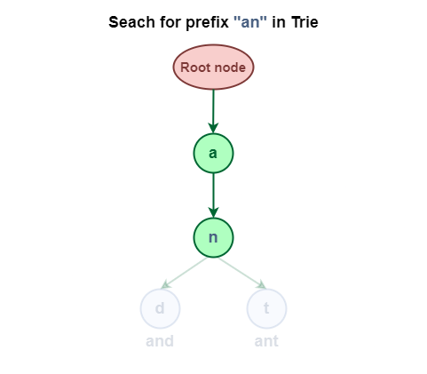
2.1 Searching Prefix in Trie Data Structure
Search for the prefix “an” in the Trie Data Structure.

Slide 21
Implementation of Prefix Search in Trie data structure
bool isPrefixExist(TrieNode* root, string& key)
{
// Initialize the currentNode pointer
// with the root node
TrieNode* currentNode = root;
// Iterate across the length of the string
for (auto c : key) {
// Check if the node exist for the current
// character in the Trie.
if (currentNode->childNode == NULL) {
// Given word as a prefix does not exist in Trie
return false;
}
// Move the currentNode pointer to the already
// existing node for current character.
currentNode = currentNode->childNode;
}
// Prefix exist in the Trie
return true;
}

Slide 22
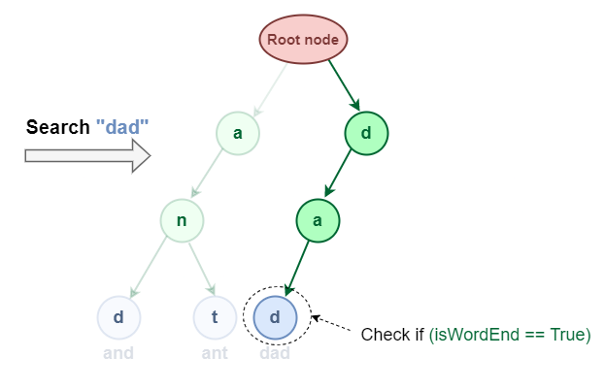
2.2 Searching Complete word in Trie Data Structure
It is similar to prefix search but additionally, we have to check if the word is ending at the last character of the word or not

Slide 23
Implementation of Search in Trie data structure
bool search_key(TrieNode* root, string& key)
{
// Initialize the currentNode pointer
// with the root node
TrieNode* currentNode = root;
// Iterate across the length of the string
for (auto c : key) {
// Check if the node exist for the current
// character in the Trie.
if (currentNode->childNode == NULL) {
// Given word does not exist in Trie
return false;
}
// Move the currentNode pointer to the already
// existing node for current character.
currentNode = currentNode->childNode;
}
return (currentNode->wordCount > 0);
}

Slide 24
3. Deletion in Trie Data Structure
This operation is used to delete strings from the Trie data structure. There are three cases when deleting a word from Trie.
The deleted word is a prefix of other words in Trie.
The deleted word shares a common prefix with other words in Trie.
The deleted word does not share any common prefix with other words in Trie.

Slide 25
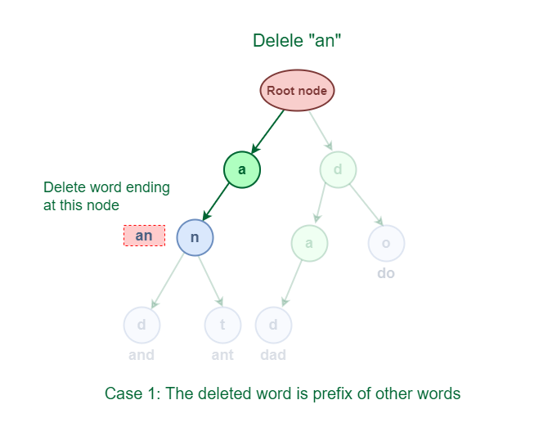
3.1 The deleted word is a prefix of other words in Trie
The deleted word “an” share a complete prefix with another word “and” and “ant“
An easy solution to perform a delete operation for this case is to just decrement the wordCount by 1 at the ending node of the word

Slide 26
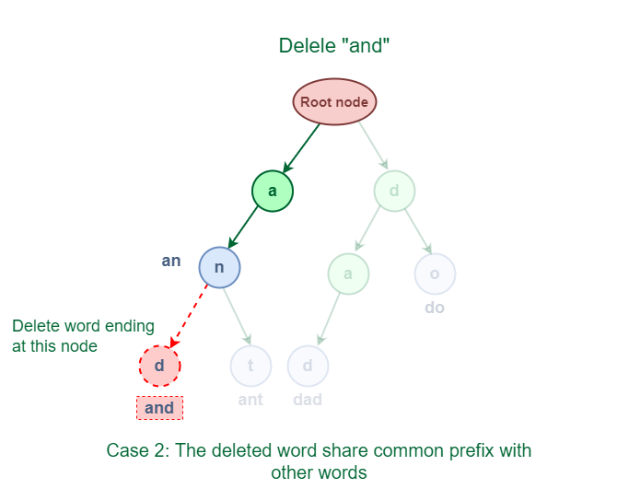
3.2 The deleted word shares a common prefix with other words in Trie
The deleted word “and” has some common prefixes with other words ‘ant’. They share the prefix ‘an’.
The solution for this case is to delete all the nodes starting from the end of the prefix to the last character of the given word.

Slide 27
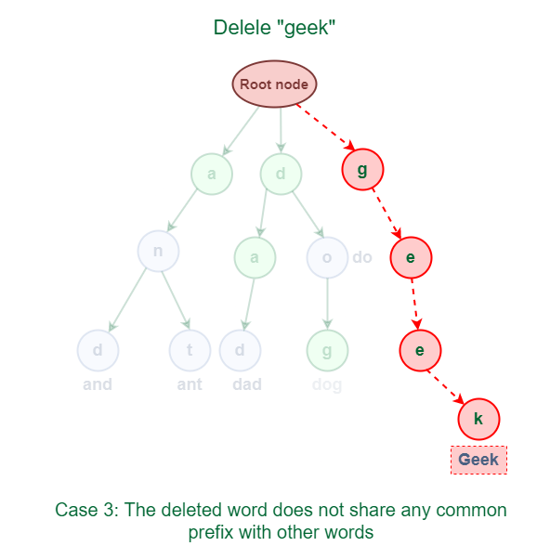
3.3 The deleted word does not share any common prefix with other words in Trie
The word “geek” does not share any common prefix with any other words.
The solution for this case is just to delete all the nodes.

Slide 28
Implementation of all the cases
bool delete_key(TrieNode* root, string& word)
{
TrieNode* currentNode = root;
TrieNode* lastBranchNode = NULL;
char lastBrachChar = 'a';
for (auto c : word) {
if (currentNode->childNode == NULL) {
return false;
}
else {
int count = 0;
for (int i = 0; i < 26; i++) {
if (currentNode->childNode[i] != NULL)
count++;
}
if (count > 1) {
lastBranchNode = currentNode;
lastBrachChar = c;
}
currentNode = currentNode->childNode;
}
}

Slide 29
Implementation of all the cases
int count = 0;
for (int i = 0; i < 26; i++) {
if (currentNode->childNode[i] != NULL)
count++;
}
// Case 1: The deleted word is a prefix of other words
// in Trie.
if (count > 0) {
currentNode->wordCount--;
return true;
}
// Case 2: The deleted word shares a common prefix with
// other words in Trie.
if (lastBranchNode != NULL) {
lastBranchNode->childNode[lastBrachChar] = NULL;
return true;
}
// Case 3: The deleted word does not share any common
// prefix with other words in Trie.
else {
root->childNode[word[0]] = NULL;
return true;
}
}

Slide 30
Applications of Trie data structure
1. Autocomplete Feature: Autocomplete provides suggestions based on what you type in the search box. Trie data structure is used to implement autocomplete functionality
2. Spell Checkers: If the word typed does not appear in the dictionary, then it shows suggestions based on what you typed. It is a 3-step process that includes :
Checking for the word in the data dictionary.
Generating potential suggestions.
Sorting the suggestions with higher priority on top.
Trie stores the data dictionary and makes it easier to build an algorithm for searching the word from the dictionary and provides the list of valid words for the suggestion.

Slide 31
Applications of Trie data structure
3. Longest Prefix Matching Algorithm(Maximum Prefix Length Match): This algorithm is used in networking by the routing devices in IP networking. Optimization of network routes requires contiguous masking that bound the complexity of lookup a time to O(n), where n is the length of the URL address in bits.
To speed up the lookup process, Multiple Bit trie schemes were developed that perform the lookups of multiple bits faster.

Slide 32
Advantages of Trie data structure
Trie allows us to input and finds strings in O(l) time, where l is the length of a single word. It is faster as compared to both hash tables and binary search trees.
It provides alphabetical filtering of entries by the key of the node and hence makes it easier to print all words in alphabetical order.
Trie takes less space when compared to BST because the keys are not explicitly saved instead each key requires just an amortized fixed amount of space to be stored.
Prefix search/Longest prefix matching can be efficiently done with the help of trie data structure.
Since trie doesn’t need any hash function for its implementation so they are generally faster than hash tables for small keys like integers and pointers.
Tries support ordered iteration whereas iteration in a hash table will result in pseudorandom order given by the hash function which is usually more cumbersome.
Deletion is also a straightforward algorithm with O(l) as its time complexity, where l is the length of the word to be deleted.

Slide 33
Disadvantages of Trie data structure
The main disadvantage of the trie is that it takes a lot of memory to store all the strings. For each node, we have too many node pointers which are equal to the no of characters in the worst case.
An efficiently constructed hash table(i.e. a good hash function and a reasonable load factor) has O(1) as lookup time which is way faster than O(l) in the case of a trie, where l is the length of the string.

